Slide 1
The Application Layer
Distributed System Models & Patterns

Slide 2
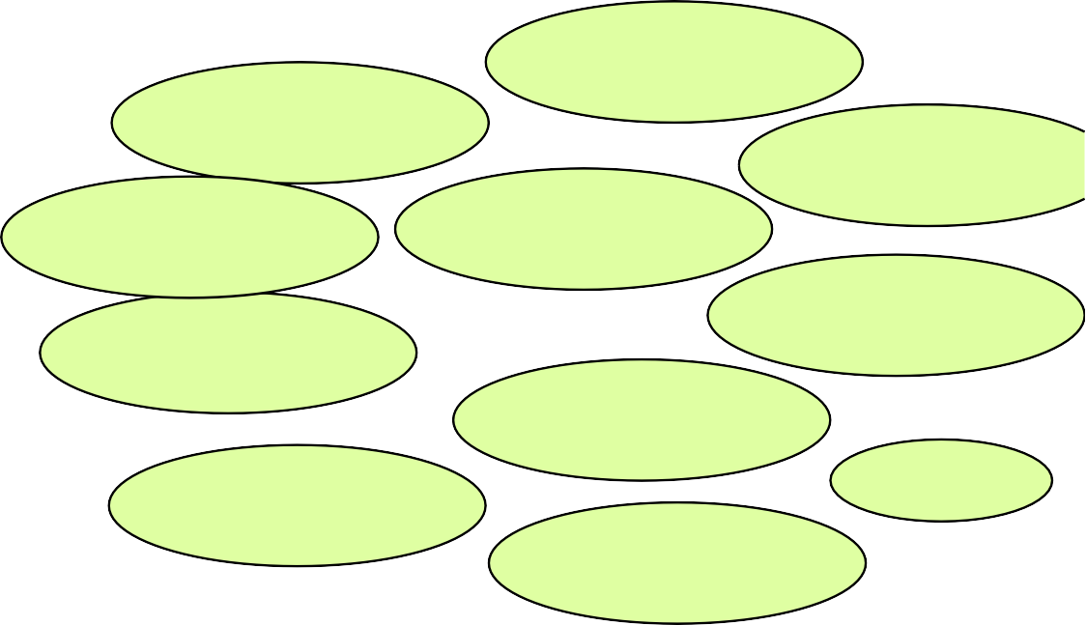
Distributed Systems
“A distributed system is a system in which components located at networked nodes (computers) communicate and coordinate their actions only by passing messages.”
Coulouris, Dollimore, Kindberg, Blair Distributed Systems: Concepts and Design (5e)
Creative and Entertainment
Examples:
⬆Web
⬆ Video Streaming
⬆ Live video calls
⬆ DNS
Finance and
Commerce
Network Management
Smart Cities
Healthcare
Science
Education
Transport and Logistics
Environmental management
…
Energy

Slide 3
Distributed Systems: Models
Representation: Different models capture different aspects of a distributed system
Physical Model
Architecture

Slide 4
Physical Models
“A representation of H/W elements of a distributed system that abstracts away from specific technologies”
Coulouris, Dollimore, Kindberg, Blair Distributed Systems: Concepts and Design (5e)
Early distributed systems (until 1990) 10-100 nodes in a LAN, limited Internet connectivity, supported by local services (file and print servers)
Contemporary distributed systems Mobile Computing Cloud/Edge Services

Slide 5
Architecture Models
Logical components and their interrelationships
Toy example: Web-based retail components
User front-end
Inventory maintenance
Logistics
Authentication logic
Payment handling

Slide 6
Architecture Models
What are the entities?
Which entities communicate, why and when?
How do they map on the physical model? (e.g. inventory and logistics could map on the same physical device)

Slide 7
Communication Patterns
Examples:
Direct Communication
Request-Response (HTTP in today’s web)
Remote Procedure Call (RPC)
Remote Method Invocation (RMI)
Indirect Communication
Publish/Subscribe (MQTT)
Message Queues
Group Communication

